Slide 1
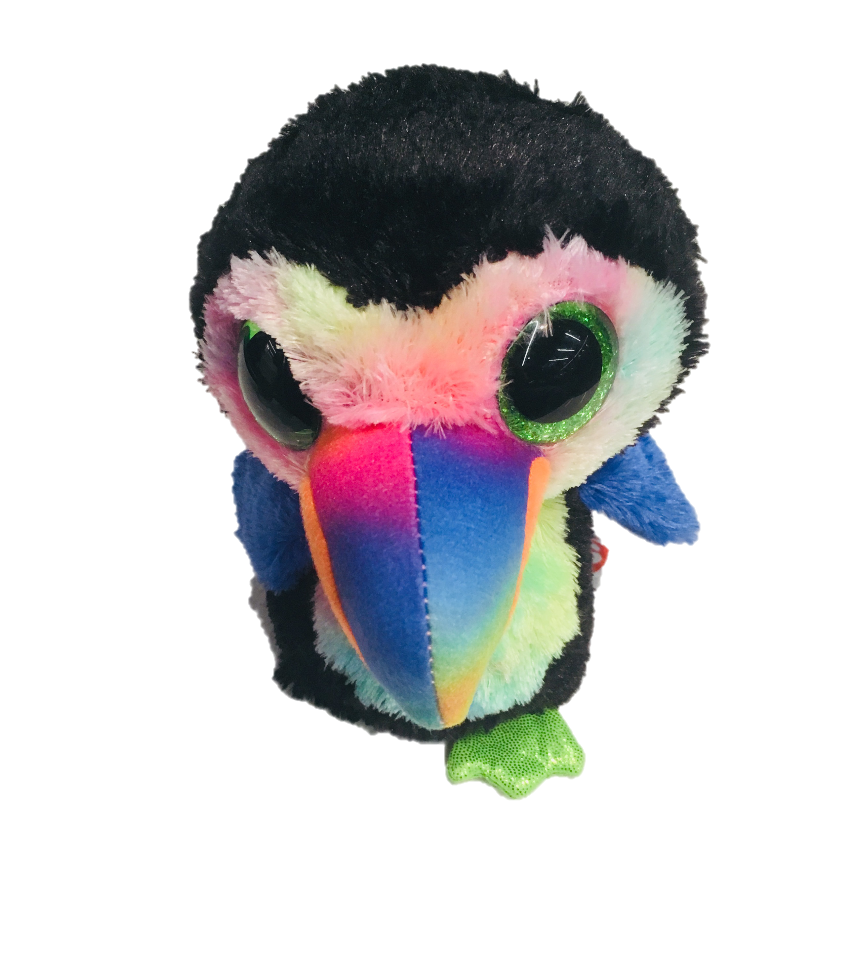
Advanced oTree
Philipp Chapkovski
European University Institute
University of Mainz
June 4-5, 2018
Custom models - Introduction

Slide 2
4-5 June 2018: Program outline
Refactoring inefficient code (Trust game)
Writing PGG with punishment (PGGFG)
Re-writing PGGFG using custom models
Adding Real Effort Task (RET) into PGGFG
Discussing individual projects

Slide 3
Two competing principles
- DRY: Do not repeat yourself.
- Premature optimization is the root of all evil. (Donald Knuth)

Slide 4
Recent changes in 2.1.5
{% if a|default:None %} {{ a }} {% endif %}

Slide 5
Trust game with shifting order
Standard Trust game
Two treatments:
T1: Sender makes the decision first; Receiver responds
T2: Receiver makes the decision first (in %); Sender observes and responds
In the end we eliciting experimenter demand by randomizing questions order
Within-subject design: 2 rounds T1; 2 Rounds T2; and vice versa.
Each page has an info that study is conducted by the Uni of Mainz

Slide 6
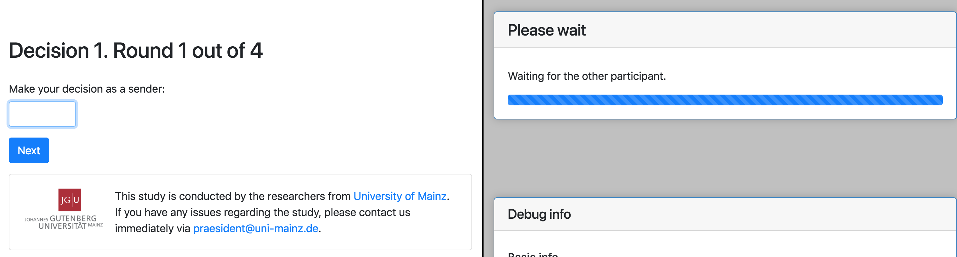
Screen 1

Slide 7
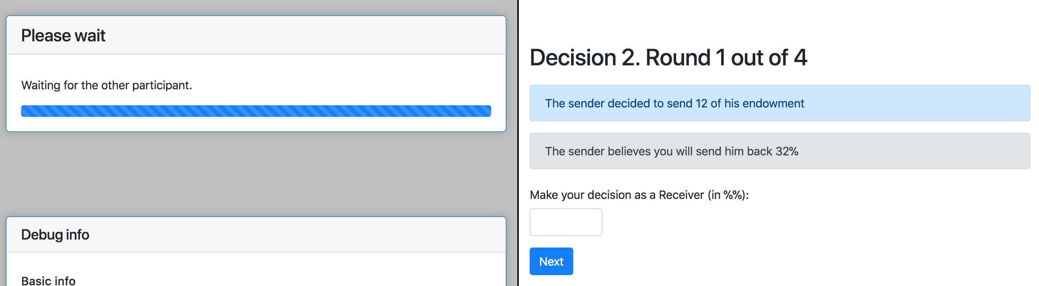
Screen 2

Slide 8
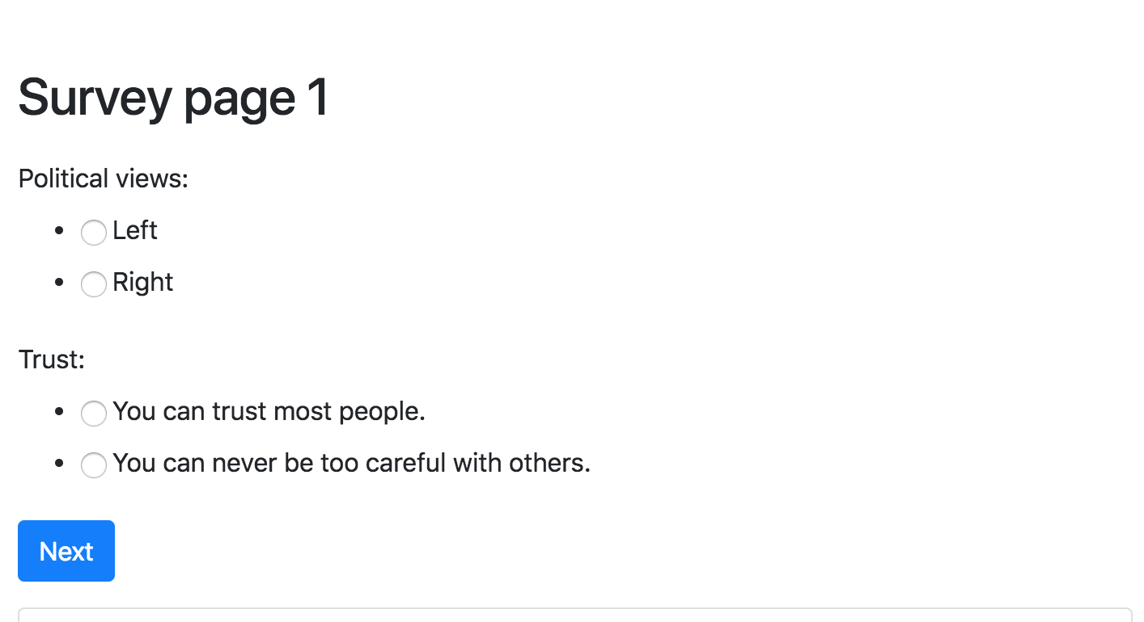
Survey page 1

Slide 9
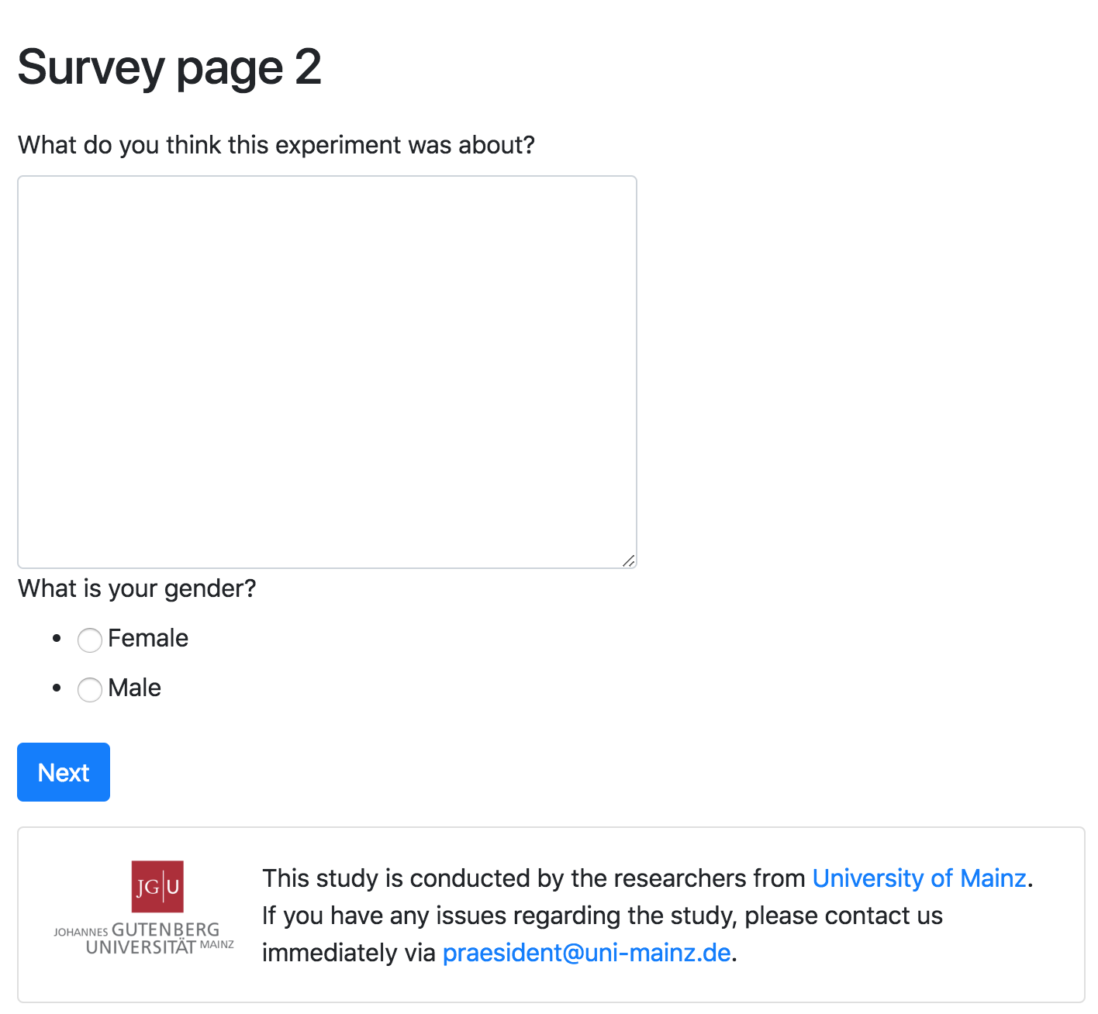
Survey page 2

Slide 10
Clean inefficiencies and errors
Find and clean as many inefficiencies as you can
https://github.com/chapkovski/mainz_task

Slide 11
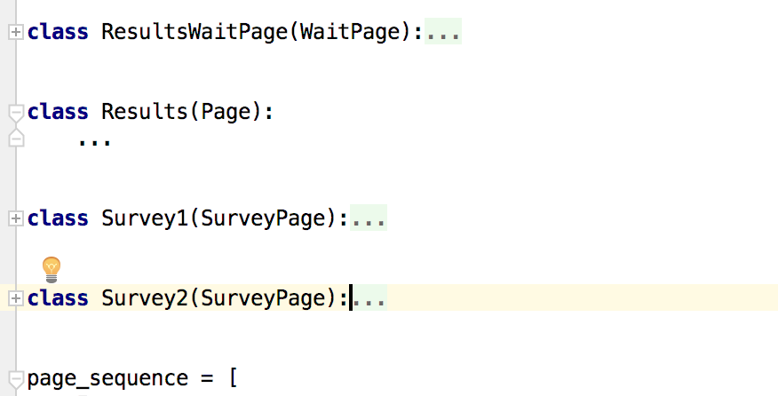
Page sequence and order of class declarion
Results: - restore the order in page sequence

Slide 12
Class inheritance
class FirstPage(Page): def is_displayed(self): return self.round_number == 1 class SurveyPage(Page): form_model = 'player' def is_displayed(self): return self.round_number == Constants.num_rounds class Intro1(FirstPage): ... class Intro2(FirstPage): def is_displayed(self): return super().is_displayed() and player.role()==‘A’ class ControlQuestions1(FirstPage): ... class ControlQuestions2(FirstPage): ...

Slide 13
Always use constants
class Constants(BaseConstants): name_in_url = 'solution_app' players_per_group = 2 num_rounds = 4 endowment = 100
multiplier = 2
sender_decision = models.IntegerField(max=Constants.endowment,…

Slide 14
Moving choices to constants
class Constants(BaseConstants): POLITICAL_CHOICES = [(0, 'Left'), (1, 'Right')] GENDER_CHOICES = [(0, 'Female'), (1, 'Male')] TRUST_CHOICES = [ (0, 'You can trust most people.'), (1, 'You can never be too careful with others.'), ]
trust = models.IntegerField(choices=Constants.TRUST_CHOICES)
Why? because then we can reuse these choices elsewhere
ATTN: use get_FOO_display()

Slide 15
Minor things
always import at the top of the file
return only once if it makes sense (in vars_for_template in Decision2)
class Decision4(Page): def vars_for_template(self): …
if curtreatment == 'T1': … return { 'decision_text': decision_text, 'belief_text': belief_text, } else: … return { 'decision_text': decision_text, 'belief_text': belief_text, }
class Survey1(Page): def get_form_fields(self): import random rand = random.random() if rand < .5: random.shuffle(a) return a else: random.shuffle(b) return b

Slide 16
Treatments
class Constants(BaseConstants): treatments = ['T1', 'T2'] splitting_round = 3 class Subsession(BaseSubsession): def creating_session(self): treatment_seq = self.session.config.get('treatment_seq', Constants.treatments) assert set(treatment_seq ).issubset(Constants.treatments) for g in self.get_groups(): if self.round_number < Constants.splitting_round: g.treatment = treatment_seq[0] else: g.treatment = treatment_seq[1] class Group(BaseGroup): treatment = models.StringField()
why do I use assert?
why we need config.get?
why do I put treatment in to a group

Slide 17
Calculate payoffs at the waitpage
BEFORE:
class Results(Page): def is_displayed(self): if self.player.role() == 'sender': receiver = self.group.get_player_by_role('receiver') self.player.payoff = 100 - self.player.sender_decision + receiver.receiver_decision / 100 * self.player.sender_decision else: sender = self.group.get_player_by_role('sender') self.player.payoff = sender.sender_decision * 2 - self.player.receiver_decision / 100 * sender.sender_decision * 2 return True
AFTER:
class ResultsWaitPage(WaitPage): def after_all_players_arrive(self): self.group.set_payoffs()
Why?

Slide 18
Page refactoring
Before we had 4 decision pages that look like that:
class Decision3(Page): form_model = 'player' def is_displayed(self): treatmentseq = self.session.config['treatment_seq'] curtreatment = treatmentseq[self.round_number - 1] if curtreatment == 'T1': return self.player.role() == 'receiver' else: return self.player.role() == 'sender' def get_form_fields(self): treatmentseq = self.session.config['treatment_seq'] curtreatment = treatmentseq[self.round_number - 1] if curtreatment == 'T1': return ['receiver_beliefs'] else: return ['sender_beliefs']

Slide 19
Page refactoring: now
class Decision_1(DecisionBelief): own_field = 'decision' class Belief_1(DecisionBelief): own_field = 'beliefs' class Belief_2(DecisionBelief): own_field = 'beliefs' class Decision_2(DecisionBelief): own_field = 'decision'
in Constants:
decision_order = {'T1': ['sender', 'receiver'],
'T2': ['receiver', 'sender']}

Slide 20
Universal page
class DecisionBelief(Page): form_model = 'group' own_field = None def get_order(self): order = int(self.__class__.__name__.split('_')[1]) return int(order) - 1 def is_displayed(self): r = self.player.role() i = self.get_order() return self.player.role() == Constants.decision_order[self.group.treatment][i] def get_form_fields(self): return ['{}_{}'.format(self.player.role(), self.own_field), ]

Slide 21
Question randomization
class Constants(BaseConstants): qs_a = ['political_views', 'trust'] qs_b = ['experimenter_demand', 'gender'] question_sets = [qs_a, qs_b]
class Subsession(BaseSubsession): def creating_session(self): if self.round_number == Constants.num_rounds: for p in self.get_players(): qs = Constants.question_sets.copy() for i in qs: random.shuffle(i) random.shuffle(qs) p.qs_order = json.dumps(qs)

Slide 22
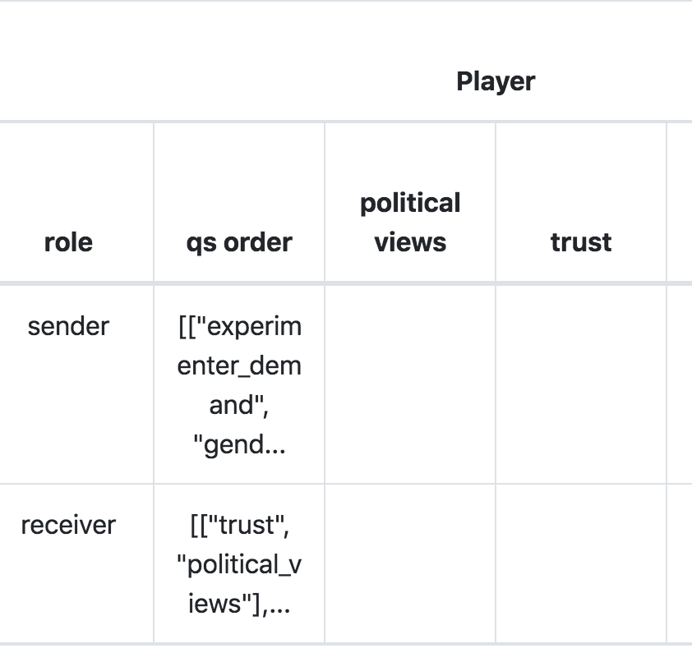
Question randomization
class Survey1(SurveyPage): def get_form_fields(self): return json.loads(self.player.qs_order)[0] class Survey2(SurveyPage): def get_form_fields(self): return json.loads(self.player.qs_order)[1]

Slide 23
Footer
moving footer to global
creating a PageExt in a _templates/global
within block content create another inner block called inner_content
move next button (wrapped in m-3 class – why?) and include/footer to PageExt
replace all references from Page to PageExt in templates

Slide 24
solution: inheriting templates
{% extends "global/Page.html" %} {% load otree static %} {% block global_styles %} {% endblock %} {% block global_scripts %} {% endblock %} {% block content %} {% block inner_content %} {% endblock %} <div class="m-5"> {% next_button %} </div> {% include 'global/footer.html' %} {% endblock %}
{% extends "global/PageExt.html" %} {% load otree static %} {% block title %} Intro 1 {% endblock %} {% block inner_content %} <div>Something here - intro</div> {% endblock %}

